Slide 1

‘C’ Programming Language
By:
Ekta Gupta

Slide 2
Language
Person 1
Person 2
Means of Communication
Languages like English , Hindi , Chinese etc.
English
English

Slide 3
Language
User
Machine
Means of Communication
Programming Languages like ‘C’ , ‘C++’ , Java
English
(High Level Language)
Binary form (0,1)
(Low Level Language)
Need Translator to convert High level to low level and vice versa. Like: Compiler , Interpreter or Assembler

Slide 4

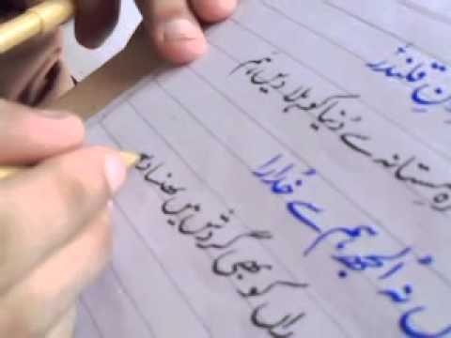
Language Approach
There are two ways to write language either:
Left to Write (E.g. English )
Write to Left (E.g. Urdu)

Slide 5
Programming Approach
There are two universal approach to write programming language either:
Procedural Programming (E.g. ‘C’ language)
Object Oriented Programming Language (E.g. ‘C++’ , ‘JAVA’ etc.)

Slide 6
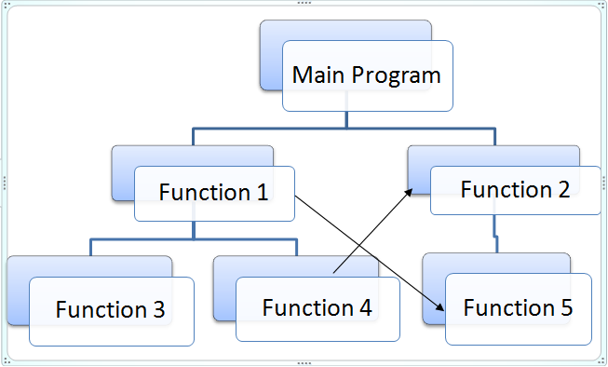
Procedural Programming

Slide 7
‘C’ Overview
C is a general-purpose, high-level language
Developed by Dennis M. Ritchie in 1972 at
AT & T Bell Labs
The UNIX operating system, the C compiler, and essentially all UNIX applications programs have been written in C

Slide 8
‘C’ Advantages
Easy to learn
Structured language
It produces efficient programs
It can handle low-level activities
It can be compiled on a variety of computer platforms

Slide 9
Facts about C
C was invented to write an operating system called UNIX.
C is a successor of B language which was introduced around 1970
The UNIX OS was totally written in C by 1973.
Today C is the most widely used and popular System Programming Language.
Most of the state-of-the-art softwares have been implemented using C.
Today's most popular Linux OS and RBDMS MySQL have been written in C.

Slide 10
Why to use C ?
Initially used for system development work, in particular the programs that make-up the operating system
C was adopted as a system development language because it produces code that runs nearly as fast as code written in assembly language.

Slide 11
Examples of the use of C
Operating Systems
Language Compilers
Assemblers
Text Editors
Print Spoolers
Network Drivers
Modern Programs
Databases
Language Interpreters
Utilities

Slide 12
‘C’ Disadvantages
No runtime checking mechanism
Does not support OOPs features
No strict type checking (we can pass an integer value for the floating data type)
Does not support Exception Handling
Doesn’t have the concept of Constructor or Destructor
Doesn’t have the concept of Namespace
There is no enough library function for handling today's programming environment
As the program extends it is very difficult to fix the bugs.

Slide 13
Sequential Programming
A sequential program will always execute the same sequence of instructions and it will always produce the same results.
Sequential program execution is deterministic.

Slide 14
Tokens in C
Tokens are the smallest individual units in a program. Like:-
Semicolons
Comments
Identifiers
Keywords
Whitespaces

Slide 15
Tokens in C
Semicolons (;) :- In C program, the semicolon is a statement terminator. That is, each individual statement must be ended with a semicolon. It indicates the end of one logical entity. For e.g.
printf("Hello, World! \n");
return 0;
Comments :- Comments are like helping text in your C program and they are ignored by the compiler. They start with /* and terminates with the characters */ as shown below:
// Hello ! My name is Ekta (Single line comment )
/ * Hello ! How are you
I am fine ! Thank you */ (Multiple lines comments )

Slide 16
Identifiers :-
A name used to identify a
Variable, function, or any other user-defined item
Starts with a letter A to Z or a to z or an underscore _
followed by zero or more letters, underscores, and digits (0 to 9)
C does not allow punctuation characters such as @, $, and % within identifiers
C is a case sensitive programming language. Thus, total and TOTAL are two different identifiers
SUM sum principal rate total
A1 result1 a_123 _abc name

Slide 17
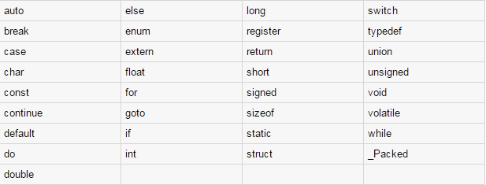
Keywords
Keywords are the reserved words in C.
These reserved words may not be used as constant or variable or any other identifier names.
There are 33 keywords used in C

Slide 18
Whitespace
A line containing only whitespace, possibly with a comment, is known as a blank line, and a C compiler totally ignores it.
Whitespace is the term used in C to describe blanks, tabs, newline characters and comments.
Whitespace separates one part of a statement from another and enables the compiler to identify where one element in a statement, such as int, ends and the next element begins.
int age;
There must be at least one whitespace character (usually a space) between int and age for the compiler to be able to distinguish them.
sum= a + b ; // get the total of value of a and b
No whitespace characters are necessary between sum and =, or between = and a,
although you are free to include some if you wish for readability purpose.

Slide 19
C Hello World Example
C++ program basically consists of the following parts:
Preprocessor Directives / Commands
Main Function
Declaring Variables
Statements & Expressions or sub functions
Comments

Slide 20
Example
#include <stdio.h>
#include <conio.h>
void main()
{
/* my first program in C */
printf("Hello, World! \n");
getch();
}
Pre processor directives
Main function
Comments
Statements

Slide 21
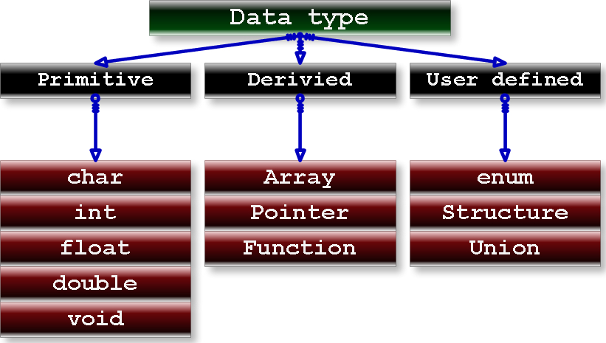

Slide 22
Primitive Data Type
Primitive Type – Primitives are like the cups at the Coffee-House.
They come in different sizes and each has name like
Small , Medium and Big

Slide 23
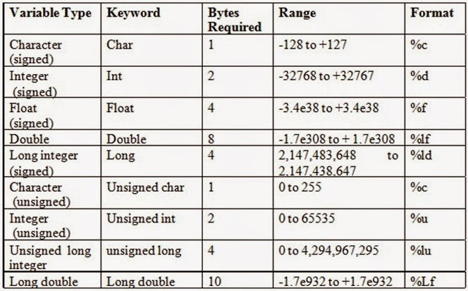

Slide 24
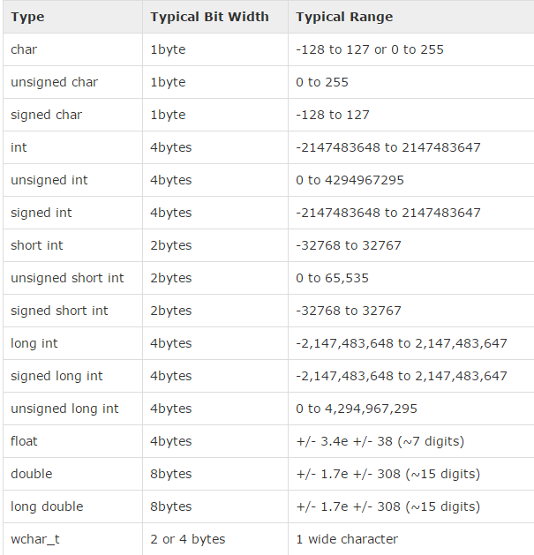

Slide 25

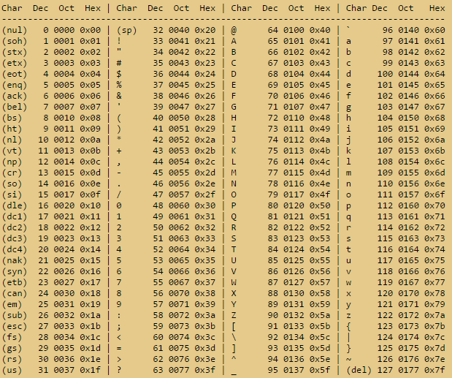

Slide 26
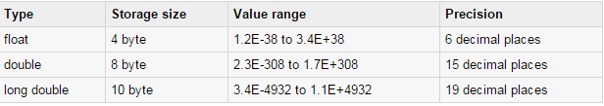
Point to Remember

Slide 27
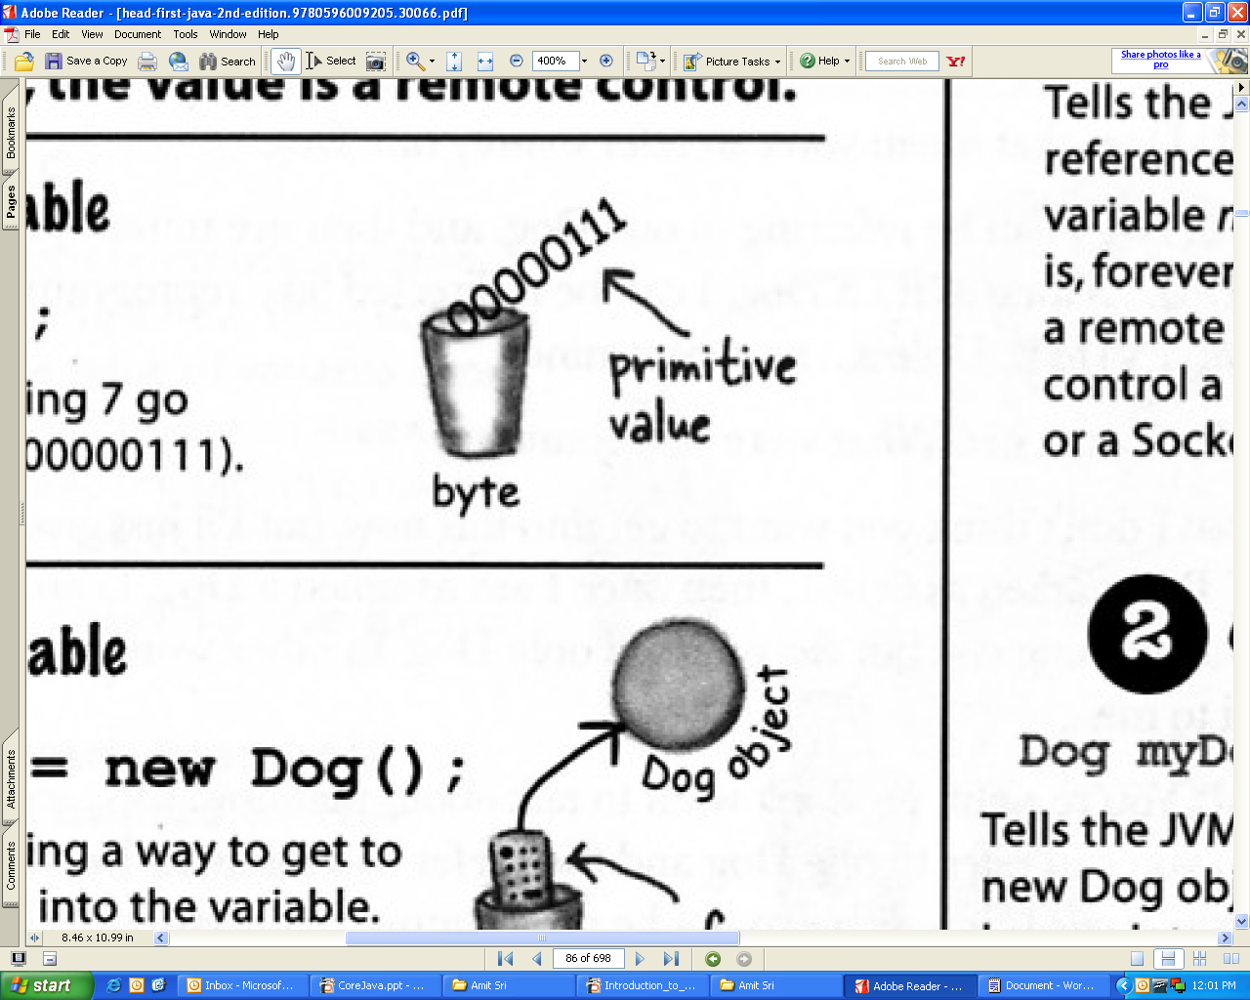
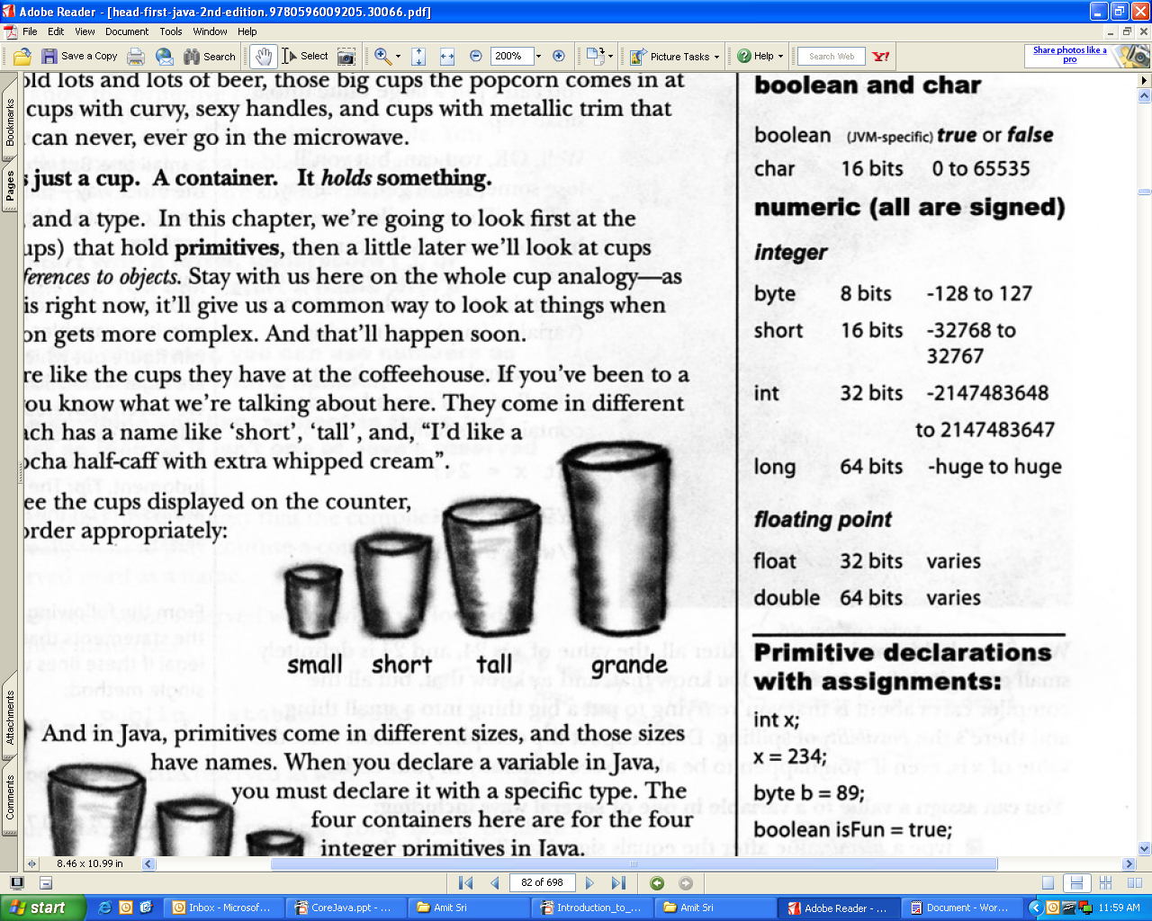
Variable
A variable is just like a cup or container. It can hold something. It has a size and a type.
Sample Example
int a=123;
a

Slide 28
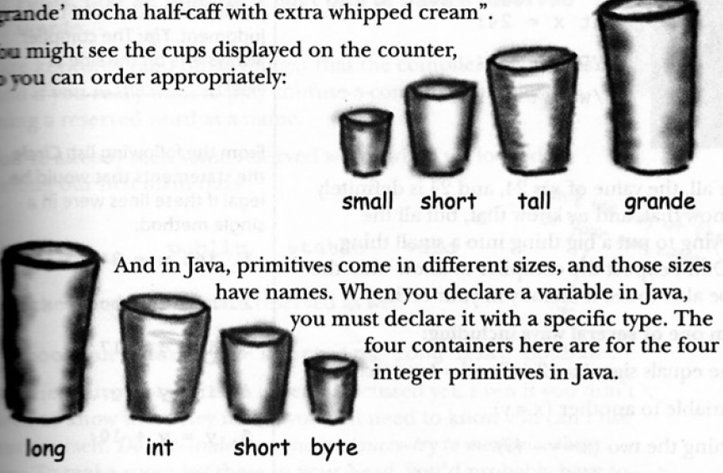
Primitive Type Example
char a = ‘b’ ; // Takes 1 byte in the memory
int a=10; // Takes 2 bytes in memory
float =5.5; // Take 4 bytes in memory

Slide 29
Constant
As the name implies , constants are fixed values which never change during the execution of the program.
The const Keyword
You can use const prefix to declare constants with a specific type as follows:
Example:
const MAX=100;

Slide 30
C - Operators
An operator is a symbol that tells the compiler to perform specific mathematical or logical manipulations.
Types of operators:
Arithmetic Operators
Relational Operators
Logical Operators
Bitwise Operators
Assignment Operators
Misc Operators

Slide 31
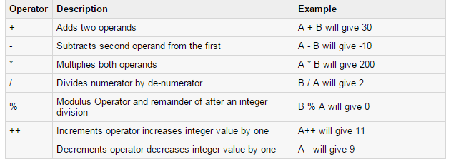
Arithmetic Operators

Slide 32
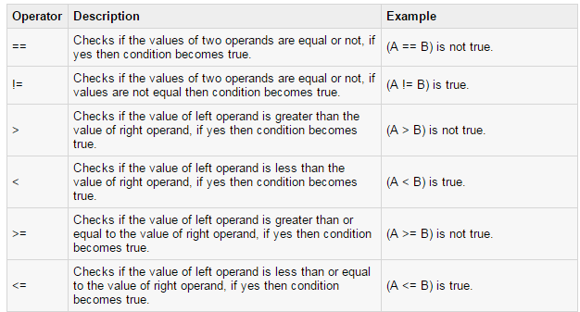
Relational Operators

Slide 33
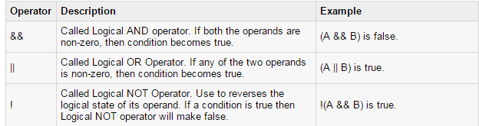
Logical Operators

Slide 34
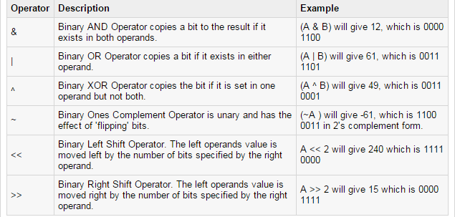
Bitwise Operators
Bitwise Operators works on bits and perform bit-by-bit operation. Like:- &, |, and ^

Slide 35
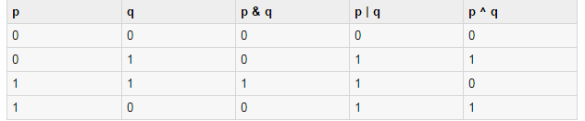
Truth Table of Bitwise Operators

Slide 36
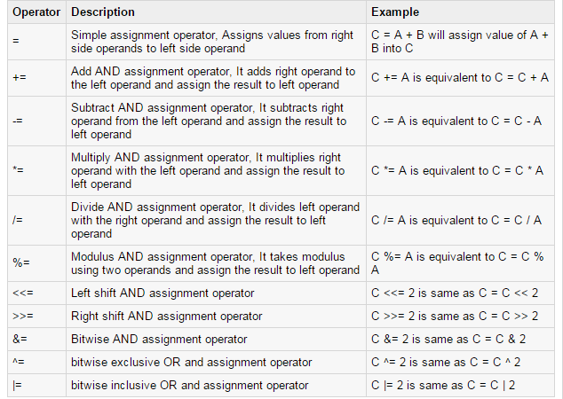
Assignment Operators

Slide 37
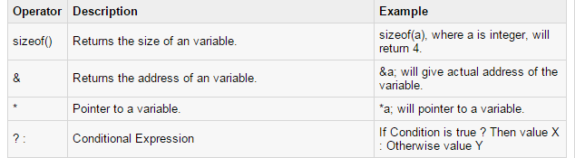
Misc Operators ↦ sizeof & ternary
There are few other important operators like :-
sizeof and ? and :
Example :
int a=10 , b;
b=(a==10)?2:3
printf(“\n value of b is %d ”,b);
Output:
value of b is 2

Slide 38
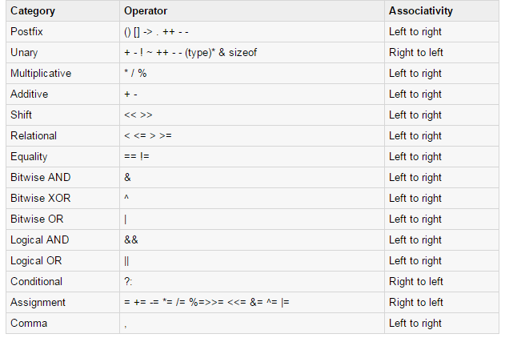
Operators Precedence in ‘C’
For Example
x = 7 + 3 * 2;
Here, x is assigned 13, not 20 because operator * has higher precedence than +, so it first gets multiplied with 3*2 and then adds into 7.

Slide 39


Decision Making Statements
1) Using if-else
2) Using switch
3) Conditional Operator (? : )

Slide 40
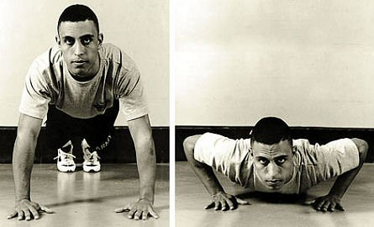
LOOPING
When you want to repeat something for definite number of times,
it is called loop.
Three basic loops
for
while
do-while

Slide 41
File Handling
A file represents a sequence of bytes, does not matter if it is a text file or binary file.
C programming language provides access on high level functions as well as low level (OS level) calls to handle file on your storage devices.

Slide 42
File Handling
A file represents a sequence of bytes on the disk where a group of related data is stored. File is created for permanent storage of data. It is a ready made structure.
In C language, we use a structure pointer of file type to declare a file.
FILE *fp;

Slide 43
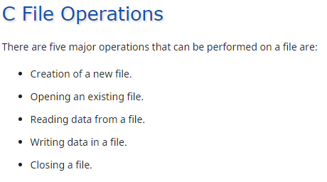
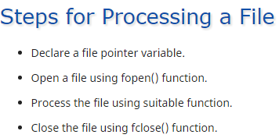

Slide 44
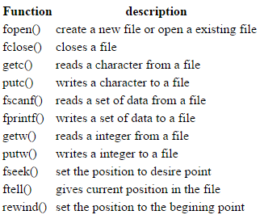
C provides a number of functions that helps to perform basic file operations. Following are the functions:-

Slide 45
Opening a File or Creating a File
The fopen() function is used to create a new file or to open an existing file.
Syntax :
*fp = FILE *fopen(const char *filename, const char *mode);
Here filename is the name of the file to be opened and mode specifies the purpose of opening the file.
*fp is the FILE pointer (FILE *fp), which will hold the reference to the opened(or created) file.

Slide 46
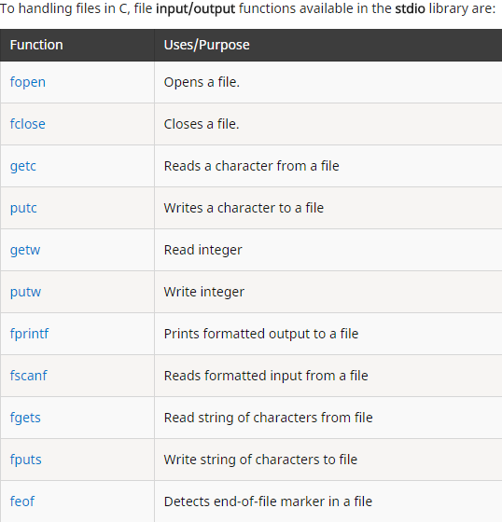

Slide 47
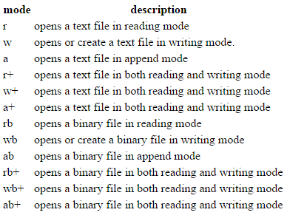
Different Types of Modes

Slide 48
Closing a File
The fclose() function is used to close an already opened file.
Syntax :
int fclose( FILE *fp );
Here fclose() function closes the file and returns zero on success, or EOF if there is an error in closing the file. This EOF is a constant defined in the header file stdio.h.

Slide 49
Program to read and write individual characters to a file
#include<stdio.h>
#include<conio.h>
void main()
{
FILE *fp;
char ch[10];
fp = fopen("one.txt", "w");
printf("Enter data");
while( (ch = getchar()) != EOF)
{
putc(ch,fp);
}
fclose(fp);
// Read from file
fp = fopen("one.txt", "r");
while( (ch = getc()) != EOF)
{
printf("%c",ch);
}
fclose(fp);
getch();
}
getc() and putc() are simplest functions used to read and write individual characters to a file

Slide 50
Reading and Writing from File using fprintf() and fscanf()
#include<stdio.h>
#include<conio.h>
struct emp
{
char name[10];
int age;
};
void main()
{
struct emp e;
FILE *p,*q;
p = fopen("one.txt", "a");
q = fopen("one.txt", "r");
printf("Enter Name and Age");
scanf("%s %d", e.name, &e.age);
fprintf(p,"%s %d", e.name, e.age);
fclose(p);
while( !feof(q))
{
fscanf(q,"%s %d", e.name, e.age);
printf("%s %d", e.name, e.age);
}
getch();
}
In this program, we have create two FILE pointers and both are referring to the same file but in different modes. fprintf() function directly writes into the file, while fscanf() reads from the file, which can then be printed on console using standard printf() function.

Slide 51
Difference between Append and Write Mode
Write (w) mode and Append (a) mode, while opening a file are almost the same. Both are used to write in a file. In both the modes, new file is created if it doesn't exists already.
The only difference they have is, when you open a file in the write mode, the file is reset, resulting in deletion of any data already present in the file.
While in append mode this will not happen. Append mode is used to append or add data to the existing data of file(if any).
Hence, when you open a file in Append(a) mode, the cursor is positioned at the end of the present data in the file.

Slide 52
Reading and Writing in a Binary File
A Binary file is similar to the text file, but it contains only large numerical data.
fread() and fwrite() functions are used to read and write is a binary file.
fwrite(data-element-to-be-written, size_of_elements, number_of_elements, pointer-to-file);
fread() is also used in the same way, with the same arguments like fwrite() function.
Below mentioned is a simple example of writing into a binary file
const char *mytext = "The quick brown fox jumps over the lazy dog";
FILE *bfp= fopen("test.txt", "wb");
if (bfp)
{
fwrite(mytext, sizeof(char), strlen(mytext), bfp) ;
fclose(bfp) ;
}

Slide 53
fseek(), ftell() and rewind() functions
fseek() - It is used to move the reading control to different positions using fseek function.
ftell() - It tells the byte location of current position of cursor in file pointer.
rewind() - It moves the control to beginning of the file.

Slide 54
//THIS PROGRAM WRITE RECORDS IN A FILE AND THEN READ IT RECORDS IN SORTED ORDER BY NAMES IN RECORD AND DISPLAY THEM ON SCREEN void main() { FILE *fw,*fr; char opsn=’y'; char *p; int count=0;
//for writing records into file struct student { char name[20]; int age; }s;
fw=fopen(“op.txt”,”w”); while(opsn==’y’) { count++; printf(“Enter student name and age\n”); scanf(“%s%d”,s.name,&s.age); fprintf(fw,”%3s%3d\n”,s.name,s.age); printf(“Wanna enter another record(y|n)\n”); fflush(stdin); opsn=getche(); } fclose(fw);
//for reading records rom file
fr=fopen(“op.txt”,”r”); struct st { char nm[20]; int ag; }s2[count];
printf(“\nRecord from file is\n”); int i=0,j; char temp[20]; while(fscanf(fr,”%s%d”,s.name,&s.age)!=EOF) { strcpy(s2[i].nm,s.name); s2[i].ag=s.age; i++; }

Slide 55
Cont….
// for sorting records
for(i=0;i<count;i++) {
for(j=i+1;j=<count;j++) { strcpy(temp,s2[i].nm); strcpy(s2[i].nm,s2[j].nm); strcpy(s2[j].nm,temp); }}}
//for displaying records
for(i=0;i<count;i++) printf("\n%s\t\t%d",s2[i].nm,s2[i].ag); fclose(fr);
getch(); }

Slide 56
Strings- Introduction
String data type is not supported in C Programming.
String means Collection of Characters to form particular word.
String is useful whenever we accept name of the person, Address of the person, some descriptive information.
We cannot declare string using String Data Type, instead of we use array of type character to create String.
Character Array is Called as ‘String’

Slide 57


Strings
Collection or array of characters are called strings.
A string is terminated by null character (\0)
For example:
Declaration of strings
Strings are declared in C in similar manner as arrays. Only difference is that, strings are of char type.
For example : char s[5];
E
K
T
A
\0

Slide 58
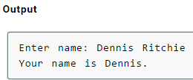
Reading Strings from user.
For example :-
char c[20];
scanf("%s",&c);
printf(“%s”,c);
#include <stdio.h>
void main()
{
char name[20];
printf("Enter name: ");
scanf("%s",&name);
printf("Your name is %s",name);
}
String variable c can only take a word. It is because when white space is encountered, the scanf()function terminates.
Here, program will ignore Ritchie because, scanf() function takes only string before the white space.

Slide 59
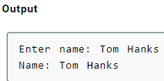
gets() and puts() are two string functions to take string input from user and display string
void main()
{
char name[30];
printf("Enter name: ");
gets(name); //Function to read string from user.
printf("Name: ");
puts(name); //Function to display string.
}

Slide 60
String handling functions
You can perform different type of string operations manually like:
finding length of string
concatenating(joining) two strings
reverse of string
But, for programmers ease, many library function are defined under header file <string.h> to handle these commonly used talk in C programming.

Slide 61
String handling functions
Strings are often needed to be manipulated by programmer according to the need of a problem.
All string manipulation can be done manually by the programmer but, this makes programming complex and large.
To solve this, the C supports a large number of string handling functions.
There are numerous functions defined in <string.h> header file.

Slide 62
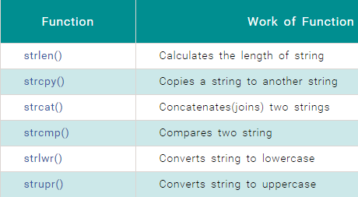

Slide 63
C Strings Initialization
Whenever we declare a String then it will contain garbage values inside it. We have to initialize String or Character array before using it. Process of Assigning some legal default data to String is Called Initialization of String.
There are different ways of initializing String in C Programming –
Initializing Unsized Array of Character
Initializing String Directly
Initializing String Using Character Pointer

Slide 64
Way 1 : Unsized Array and Character
Unsized Array : Array Length is not specified while initializing character array using this approach
Array length is Automatically calculated by Compiler
Individual Characters are written inside Single Quotes , Separated by comma to form a list of characters. Complete list is wrapped inside Pair of Curly braces
Please Note : NULL Character should be written in the list because it is ending or terminating character in the String/Character Array

Slide 65
Way 2 : Directly initialize String Variable
In this method we are directly assigning String to variable by writing text in double quotes.
In this type of initialization , we don’t need to put NULL or Ending / Terminating character at the end of string. It is appended automatically by the compiler.

Slide 66
Way 3 : Character Pointer Variable
Declare Character variable of pointer type so that it can hold the base address of “String”
Base address means address of first array element i.e (address of name[0] )
NULL Character is appended Automatically

Slide 67
C Arithmetic Operations On Character
C Programming Allows you to Manipulate on String
Whenever the Character is variable is used in the expression then it is automatically Converted into Integer Value called ASCII value
All Characters can be Manipulated with that Integer Value.( Addition, Subtraction)
Examples :
ASCII value of : ‘a’ is 97
ASCII value of : ‘z’ is 122

Slide 68
Possible Ways of Manipulation :
Way 1: Displays ASCII value[ Note that %d in Printf ]
char x = 'a'; printf("%d",x); // Result = 97
Way 2 : Displays Character value[ Note that %c in Printf ]
char x = 'a'; printf("%c",x); // Result = a
Way 3 : Displays Next ASCII value[ Note that %d in Printf]
char x = 'a' + 1 ; printf("%d",x);
// Result = 98 ( ascii of 'b' )

Slide 69
Way 4 Displays Next Character value[Note that %c in Printf ]
char x = 'a' + 1; printf("%c",x); // Result = 'b‘
Way 5 : Displays Difference between 2 ASCII in Integer[Note %d in Printf ]
char x = 'z' - 'a'; printf("%d",x);
//Result = 25 (difference between ASCII of z and a )
Way 6 : Displays Difference between 2 ASCII in Char [Note that %c in Printf ]
char x = 'z' - 'a'; printf("%c",x);
//Result = ↓ ( difference between ASCII of z and a )

Slide 70
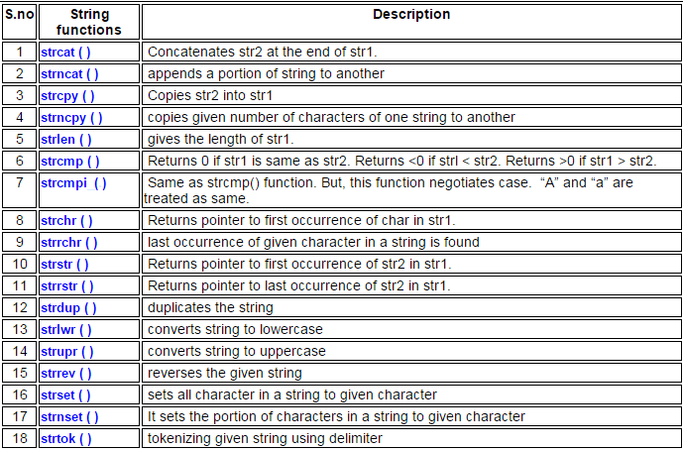

Slide 71

Program to Find the Length of a String
#include <stdio.h>
void main()
{
char s[1000],i;
printf("Enter a string: ");
scanf("%s",s);
for(i=0; s[i]!='\0'; ++i)
printf("Length of string: %d",i);
}

Slide 72
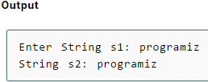
Program to Copy String Without Using strcpy()
#include <stdio.h>
int main()
{
char s1[100], s2[100], i;
printf("Enter string s1: ");
scanf("%s",&s1);
for(i=0; s1[i]!='\0'; ++i)
{
s2[i]=s1[i];
}
s2[i]='\0';
printf("String s2: %s",s2);
}

Slide 73
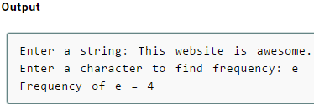
Program to Find the Frequency of Characters in a String
#include <stdio.h>
void main()
{
char c[1000],ch;
int i,count=0;
printf("Enter a string: ");
gets(c);
printf("Enter a character to find frequency: ");
scanf("%c",&ch);
for(i=0;c[i]!='\0';++i)
{
if(ch==c[i])
++count;
}
printf("Frequency of %c = %d", ch, count);
}

Slide 74
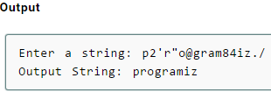
Source Code to Remove Characters in String Except Alphabets
#include<stdio.h>
#include<conio.h>
void main()
{
clrscr();
char ch[30];
int i,j;
printf("enter the character \n");
gets(ch);
for(i=0;ch[i]!='\0';i++)
{
if((ch[i]>='a'&&ch[i]<='z')||(ch[i]>='A'&&ch[i]<='Z')||(ch[i]=='\0'))
printf("%c",ch[i]);
}
getch();
}

Slide 75
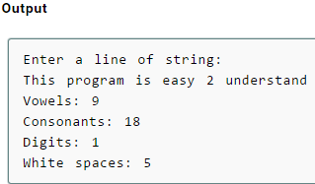
Source Code to Find Number of Vowels, Consonants, Digits and White Space Character
#include<stdio.h>
void main()
{
char line[150];
int i,v,c,ch,d,s,o;
o=v=c=ch=d=s=0;
printf("Enter a line of string:\n");
gets(line);
for(i=0;line[i]!='\0';++i)
{
if(line[i]=='a' || line[i]=='e' || line[i]=='i' || line[i]=='o' || line[i]=='u' || line[i]=='A' || line[i]=='E' || line[i]=='I' || line[i]=='O' || line[i]=='U')
++v;
else if((line[i]>='a'&& line[i]<='z') || (line[i]>='A'&& line[i]<='Z'))
++c;
else if(line[i]>='0'&&c<='9')
++d;
else if (line[i]==' ')
++s;
}
printf("Vowels: %d",v);
printf("\nConsonants: %d",c);
printf("\nDigits: %d",d);
printf("\nWhite spaces: %d",s);
}

Slide 76

Program to Find Number of Digits in a Number
#include <stdio.h>
void main()
{
int n,count=0;
printf("Enter an integer: ");
scanf("%d", &n);
while(n!=0)
{
n=n/10 ;
++count;
}
printf("Number of digits: %d",count);
}

Slide 77
Program to Compare Two Strings Without using strcmp()
void main() { char string1[5],string2[5]; int i,temp = 0; printf("Enter the string1 value:\n"); gets(string1); printf("\nEnter the String2 value:\n"); gets(string2); for(i=0; (string1[i]!='\0')||(string2[i]!='\0'); i++) { if(string1[i] != string2[i]) { temp = 1; break; }} I
if(temp == 0) printf("Both strings are same."); else printf("Both strings not same."); }

